Slide 1

Education center management system

Slide 2

Content.
Introduction.
Problem.
Scope.
Solution.
Interfaces.

Slide 3
Introduction
Through this system, the student has a direct connection between the institution. This system covers the area of student registration, mark the student attendance and search student details.

Slide 4
Problem
Problem is manual Omissions in adding data to logs. It takes a long time to do it. To avoid difficulties in getting data from attendance register.

Slide 5
Scope
Introducing Education center management system can reduce the time wasted It will enable you to manage your work efficiently.
This system can record student attendance details.
system can search student details.

Slide 6
Solution
Introducing Education center management system can reduce the time wasted It will enable you to manage your work efficiently. Within a short period of time, the dates of the student's arrival at the educational institution can be ensured.
• This system can record student id, name, subject details.
• This system can search the student details.

Slide 7
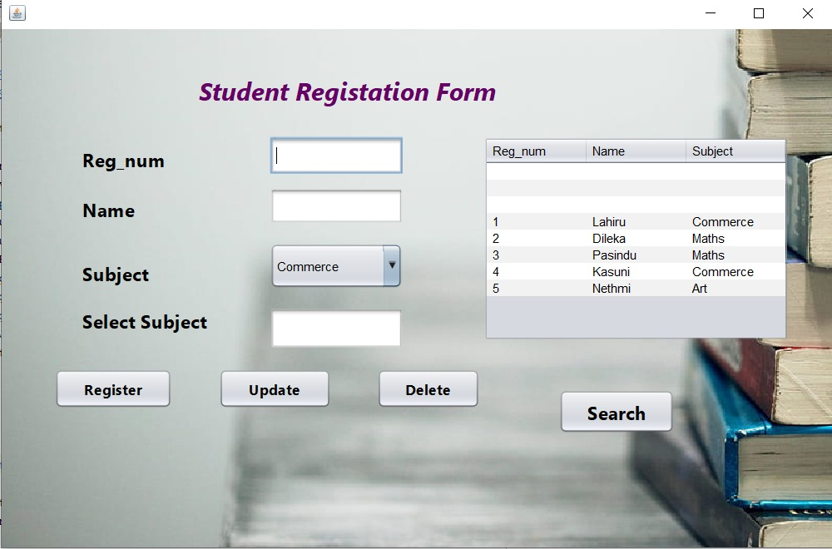
Registration Form
Here students are registered, information is updated and students are removed.

Slide 8
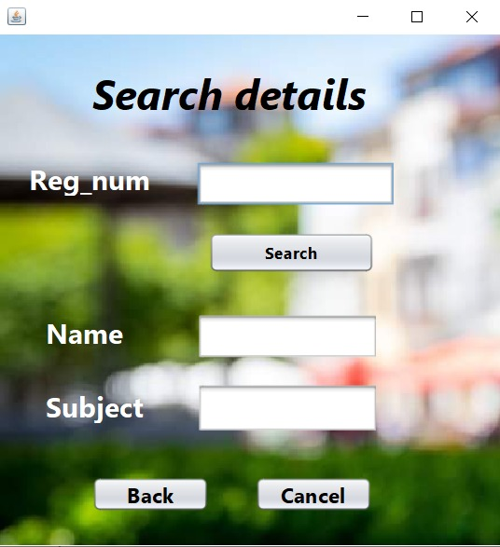
Searching Form
Availability of student information after providing the register number

Slide 9
THANK YOU…..
K.C.Dilshara Jayakodi
JL22/ICT5/1/0024

